Slide 1
CS 4974 Independent Study
11/17/22 meeting
Student: Bug Lee

Slide 2
Last time, we discussed…
Extending grammar to statements
Implementing Lexical (static) scoping using shadowing symbol table.
Building semantic analyzer and code emitter using Visiting pattern

Slide 3
Project report

Slide 4
Suggestions on what should be included in the report
Project (high level) overview/description
Design decisions and trade offs
Test strategy (What test set was created, what was being tested, etc)
Table of program created, benchmarking normal C compiler, python
Limitation
Future work

Slide 5
Current planning on report
Latex (Share document using Overleaf)
Following the ACM Conference Article Template (But Starting from scratch)

Slide 6
Open-ended topic

Slide 7
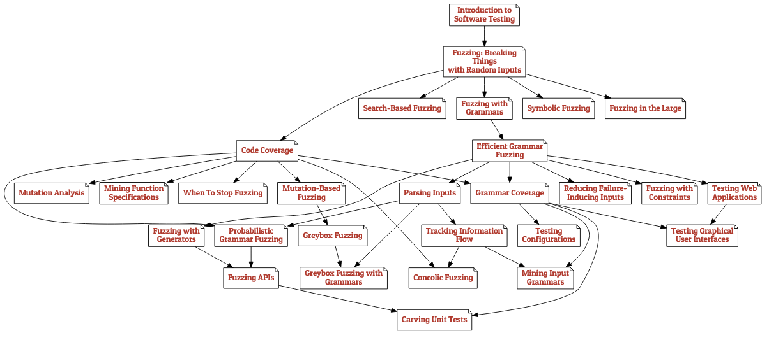
The Fuzzing Book

Slide 8
The Fuzzing Book

Slide 9
Fuzzer
Project duration: 3 weeks (including Thanksgiving break)
Language of choice: Python
Goal: Generate inputs that find bugs on one of the software (compiler, assembler, or VM).
Random program from langauge grammar

Slide 10
Plan for week 13 (Thanksgiving break)
Finish Compiler parser, semantic analyzer, and code emitter implementation.
Support Control Flow
Support Function call
Write programs in custom language!
Write first draft of project report
Do background research on open-ended project topic

